Slide 1


SHRI MATA VAISHNO DEVI UNIVERSITY
DATA STRUCTURE PROJECT:
Tank battleship
HARSH BARDHAN LAL
24BCS026
TANVI JAMWAL
24BCS084

Slide 2
C O N T E N T
INTRODUCTION
ALGORITHM/WORKING
EXPLAINATION OF CODE
DATA STRUCTURES USED
LIVE DEMONSTRATION
THANKYOU

Slide 3
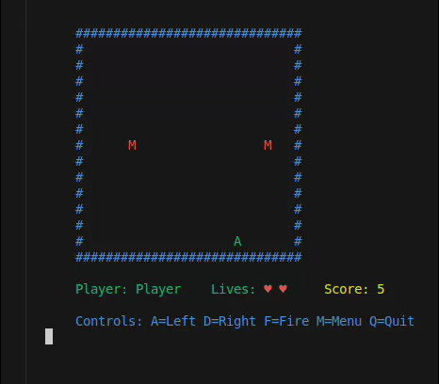
INTRODUCTION
This Tank Battleship Game is a terminal-based game implemented in C. The game features a player-controlled tank that fires bullets at enemy tanks descending from the top of the screen.

Slide 4
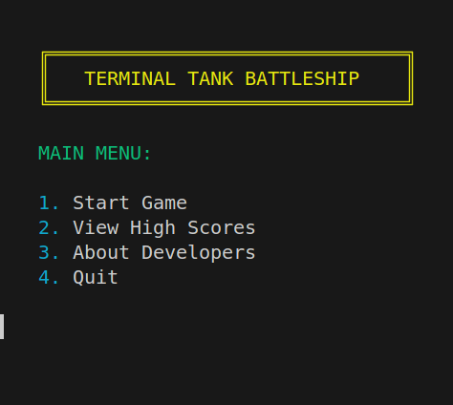
ALGORITHM
Steps followed in the execution

Slide 5
Algorithm:
The program follows this sequence:
Initialize random number generator
Load existing high scores from file
Set up terminal for game input
Display welcome screen and main menu
Based on user selection:
Start game
View high scores
View developer information
Quit
When exiting, restore terminal settings and free memory

Slide 6
EXPLAINATION OF CODE
Better understanding the code

Slide 7
Key Components Explained
Terminal Setup
Configures the terminal for raw input mode
Disables echo and canonical mode
Handles terminal restoration on exit
Game Objects
Player tank (A)
Enemy tanks (M)
Bullets (*)
Game board (2D array)

Slide 8
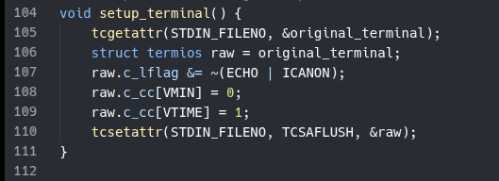
Changing terminal Behaviour:
Disables ECHO (characters typed are not displayed)
Takes input without pressing enter
Sets VMIN to 0 (read returns immediately)
Disables ECHO (characters typed are not displayed)
Disables ICANON (input is processed immediately, not line by line)
Sets VMIN to 0 (read returns immediately)
Sets VTIME to 1 (read times out after 0.1 seconds)

Slide 9
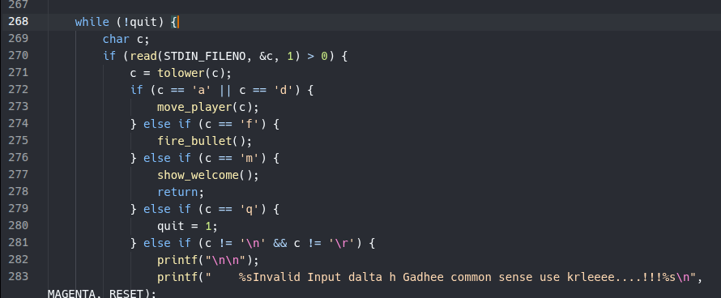
Input Handling:
Non-blocking input using raw terminal mode
Lowercase conversion for case-insensitivity
Immediate response to player actions

Slide 10
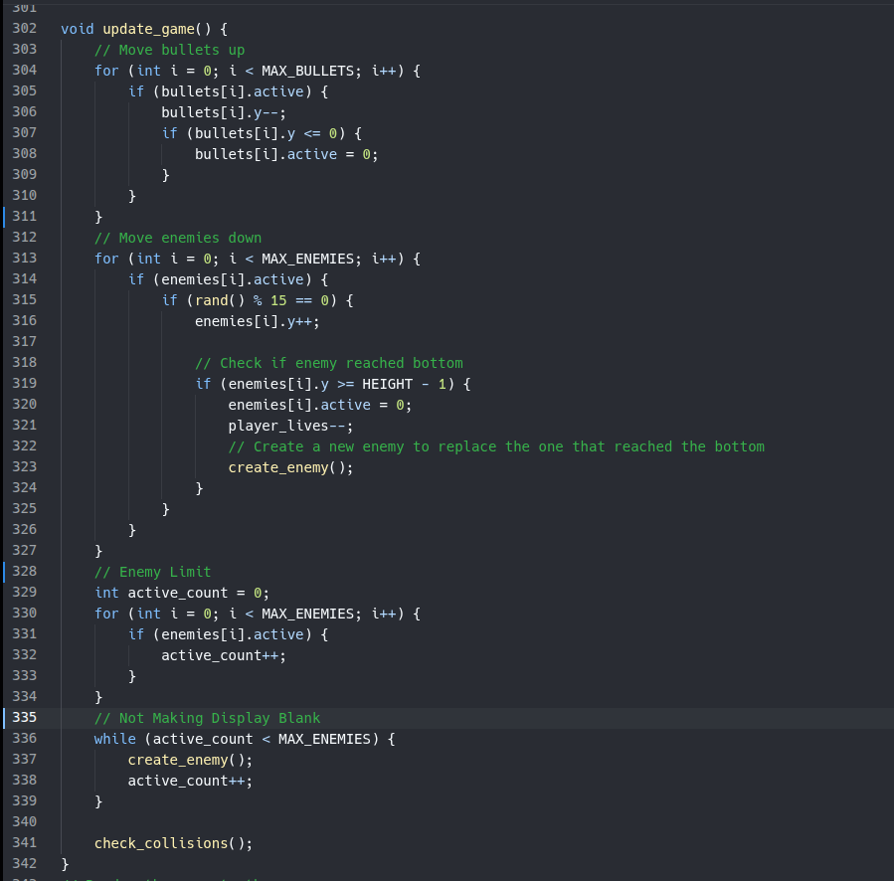
Updating Canvas:
Non-blocking input using raw terminal mode
Lowercase conversion for case-insensitivity
Immediate response to player actions

Slide 11
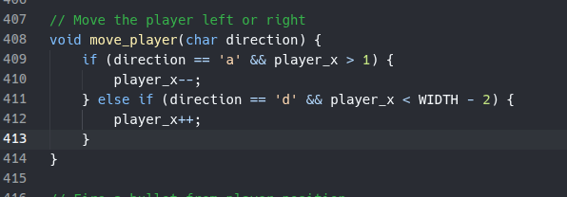
Moving Elements on Canvas
Our Canvas is a 2D Array
For Moving anything on the canvas, we are just changing its coordinates.
To avoid the Lag in the game.... we are first updating the values, then printing on the display

Slide 12
High Score Management:
he high score system uses a linked list to store scores:
typedef struct ScoreNode {
char name[MAX_PLAYER_NAME];
int score;
struct ScoreNode* next;
} ScoreNode;
he high score system uses a linked list to store scores:
typedef struct ScoreNode {
char name[MAX_PLAYER_NAME];
int score;
struct ScoreNode* next;
} ScoreNode;
he high score system uses a linked list to store scores:
typedef struct ScoreNode {
char name[MAX_PLAYER_NAME];
int score;
struct ScoreNode* next;
} ScoreNode;
Features:
Persistent storage in a text file
Sorted list (highest scores first)
Duplicate name handling (keeps highest score)
Limited to a maximum number of scores
Binary search implementation for lookup
Features:
Persistent storage in a text file
Sorted list (highest scores first)
Duplicate name handling (keeps highest score)
Limited to a maximum number of scores
Binary search implementation for lookup
Features:
Persistent storage in a text file
Sorted list (highest scores first)
Duplicate name handling (keeps highest score)
Limited to a maximum number of scores
Binary search implementation for lookup
Permanent storage in high_scores.txt
Linked list data structure for scores
Displays top 3 scores with medals
Shows total number of scores available
CONDITIONS
If player already has an entry in file, checks if current score is more than the previous time then modifies it into the file.

Slide 13
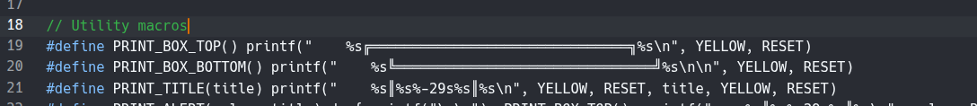


Code Optimization Techniques
Used Utility Macros for reused elements.
Function Reuse: Common functionality is encapsulated in functions
Array Usage for Visual Elements:

Slide 14
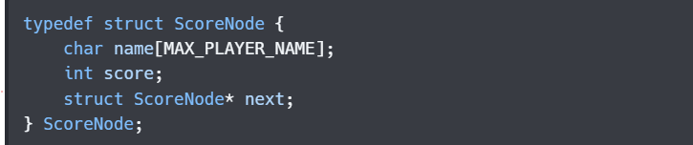
DATA STRUCTURES :
1.Linked Lists
The game implements a singly linked list for high score storage:
Operations include:
Creating nodes: create_score_node()
Adding scores: add_high_score()
Finding entries: find_player_entry()
Freeing the list: free_score_list()
Loading/saving from file: load_high_scores(), save_high_scores()

Slide 15
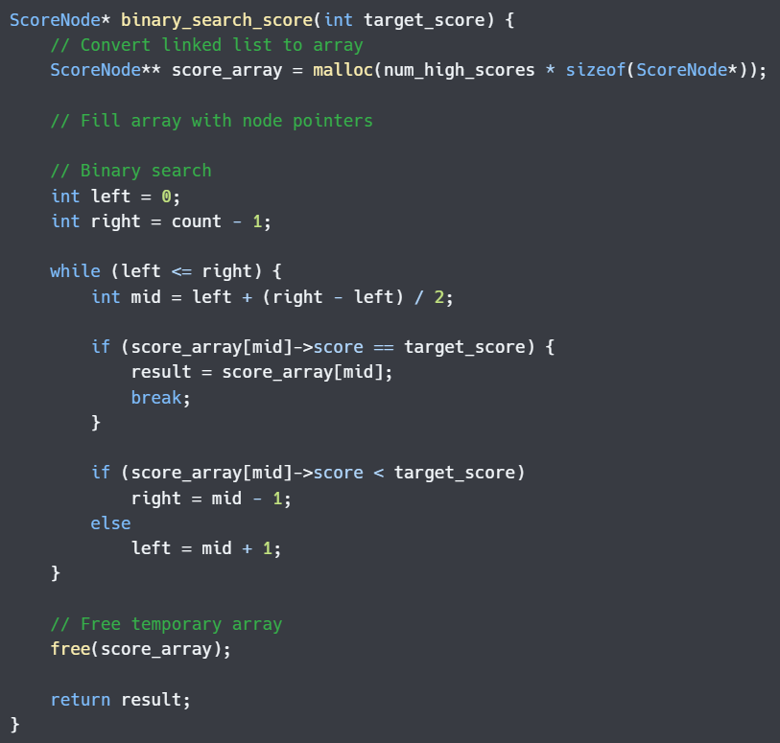
DATA STRUCTURES :
2.Binary Search Implementation:
The game includes a binary search algorithm for finding scores:
This demonstrate:
Converting a linked list to an array for binary search
The binary search algorithm
Proper memory management
Search optimization (O(log n) vs. O(n)).

Slide 16
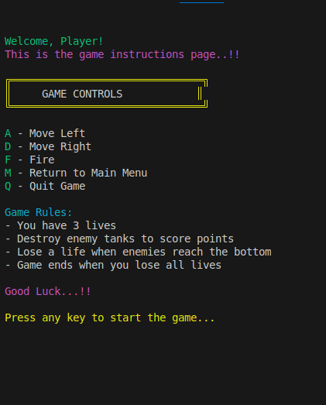
LIVE DEMONSTRATION
PRACTICAL WORKING OF THE CODE

Slide 17
Challenges/Learnings:
Terminal Input
Continuous Keyboard Input
Skipping Enter Key
Live Game Render
Tracking Multiple game objects (multiple loops)
Collision detection
Changing Text Colours
Changing text Colours for Attractive Interface

Slide 18
Future Enhancement:
More enemy types
Power-ups
Level Progression
Sound Effects
Graphical User Interface
Multiplayer Options

Slide 19
Thank you

